Slide 1
CREDIT EDA ASSIGNMENT
Made by - Tanmay

Slide 2
INTRODUCTION
In this assignment, we need to identify and do analysis of the problems faced by a loan lender from a bank as we need to take out those factors causing defaulters of repayment of loans through following datasets name:-
Application_data.csv
Previous_application.csv
We have analyzed these two datasets to find out such factors affecting clients for repayment of loans and also for those who applied loan for first time.

Slide 3
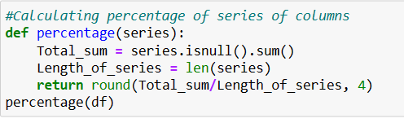
Data Processing
First we analyzed the “Application_data.csv” by going through following steps:-
We get to know the size and shape of the dataset is to be
Cleaning the data having null values:
First we started looking for info like number of columns and rows
Then from those columns we took some columns looks quite promising ot give us factors for what we doing analysis and putted them in a list then we found the null values in each column using sum command and then we add them to series before changing them into percentage.

Slide 4
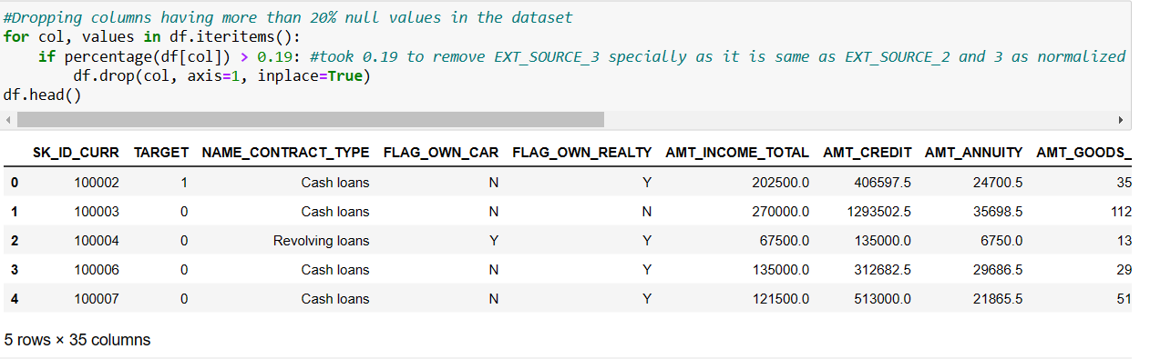
2. Removing/Dropping/fixing columns having more than 20% null values
We putted all data of null percentage in a way that more than 20% of null values of column get drop in analysis. Thereby, now we have 35 columns left with negligible/no null values.

Slide 5
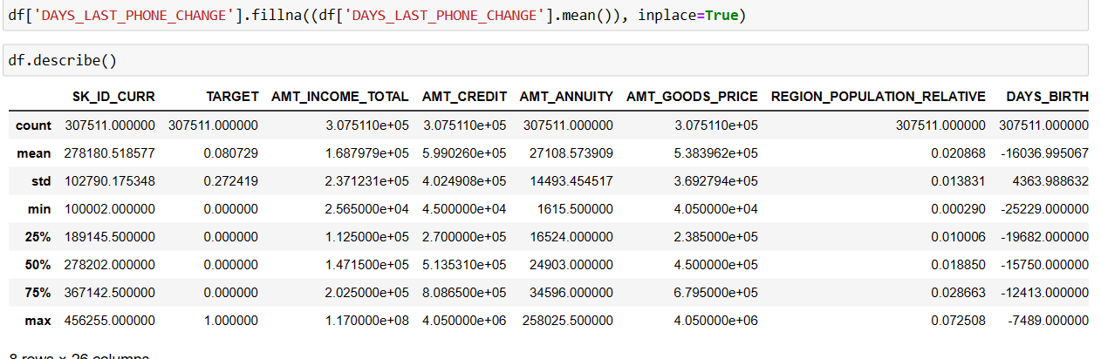
After we done dropping columns there are also few null values in some columns to fix that we took mean/median/mode accordingly for NAME_TYPE_SUITE, AMT_GOODS_PRICE, EXT_SOURCE_2, AMT_ANNUITY and DAYS_LAST_PHONE_CHANGE. After fixing columns we have now data with no null values. Hence, the columns are fixed.

Slide 6
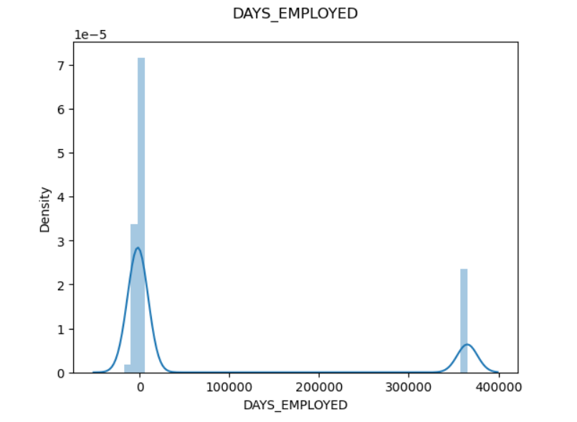
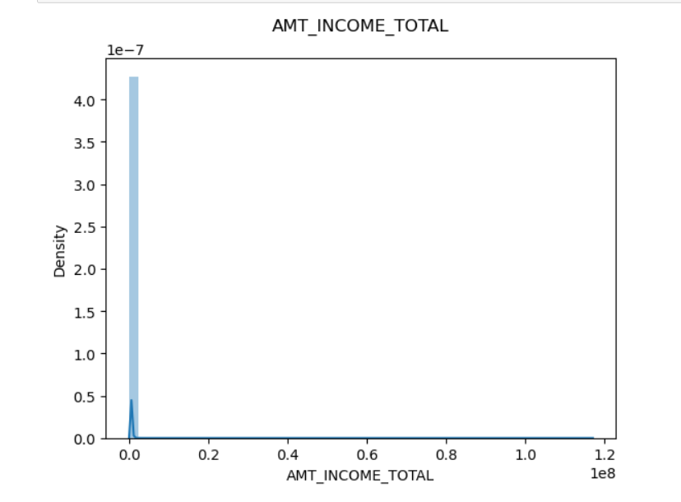
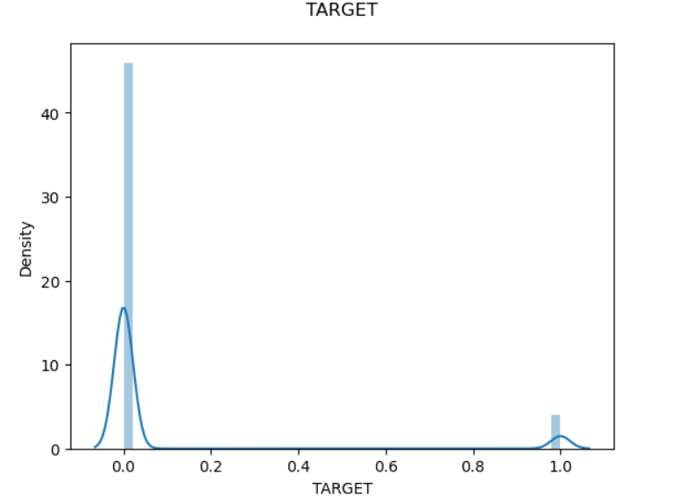
Outliers check
Generally an outlier is a value in the dataset that is extremely distinct from most of the other values and in this dataset after plotting several distplots we can see some outliers and values that are not supposed to be there.
On the below we can see there’s huge differences between values in target, days employed and Amount of income in total. These are outliers these can be fixed either by taking them to separate column or we can make separate data for higher values or lower values.

Slide 7
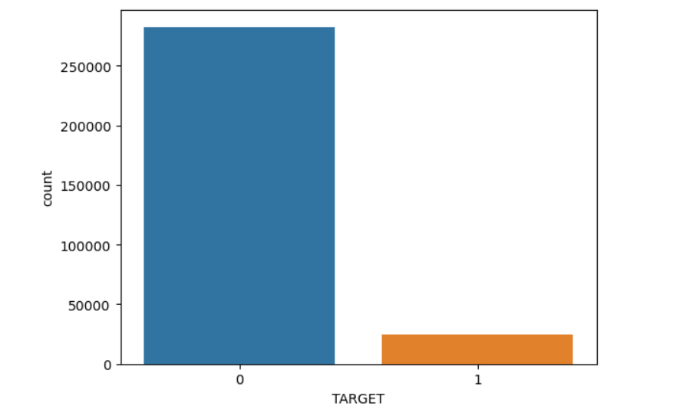
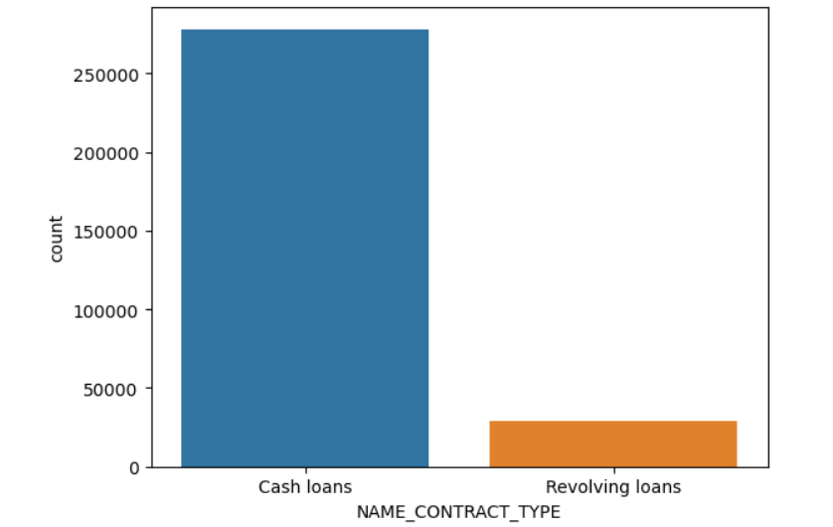
UNIVARIATE ANALYSIS
This analysis’s major purpose is to describe the dataset here in this situation we need to find defaulters and non defaulters by analysis
In the below graph we can see there are number of defaulters but less than 50k and non defaulters are more than 90% or 2.5 lakhs. And on the second graph we can see there are more people who preferred for cash loans than revolving loans.

Slide 8
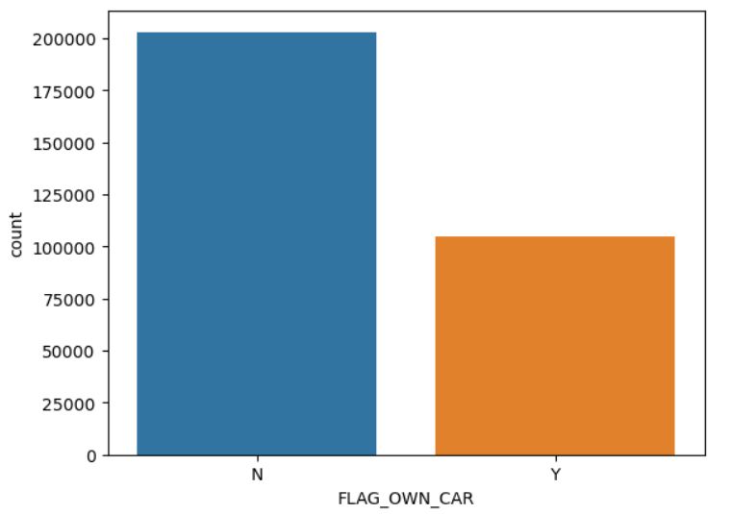
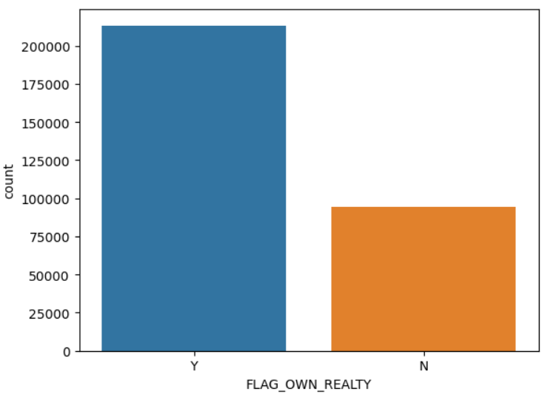
As we can see that, the client who don't own the car but repaid debts on time while other approx. 1 lakh people having car having difficulties in repayment and on other we can see that the client that owns a house or flat pays the debt on time while client having no houses are defaulters

Slide 9
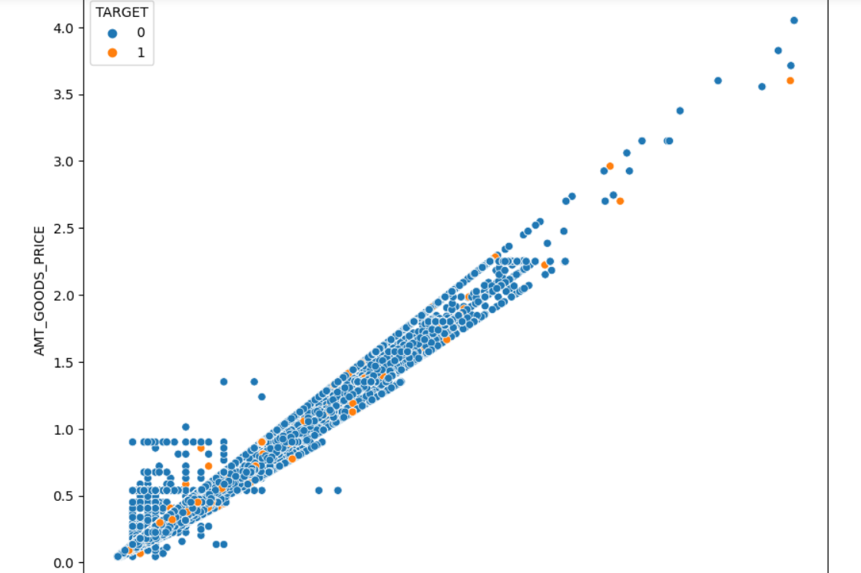
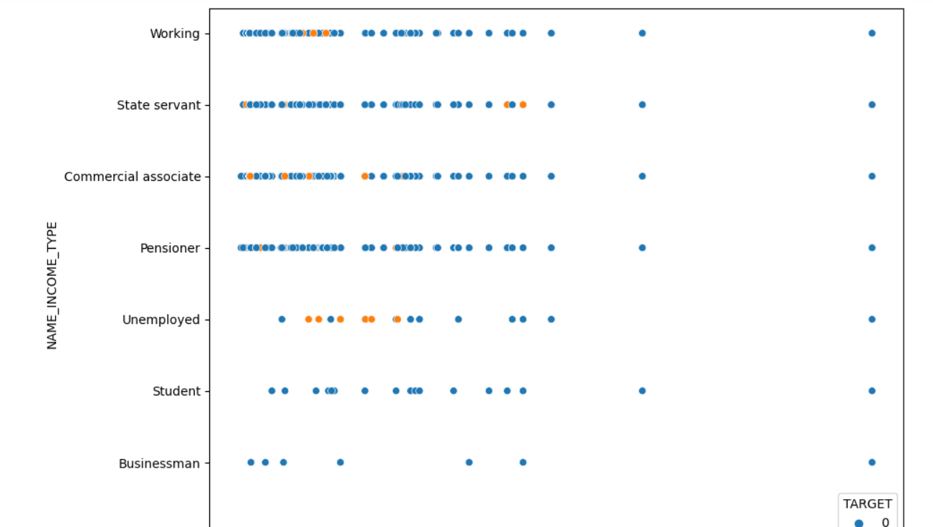
BIVARIATE ANALYSIS
Bivariate analysis is one of the statistical analysis where two variables are observed and here in this dataset below we made two graphs showing some defaulters and interactions between data’s first in amount of goods prices vs amount credited and other are name of income type vs regional population of relatives.

Slide 10
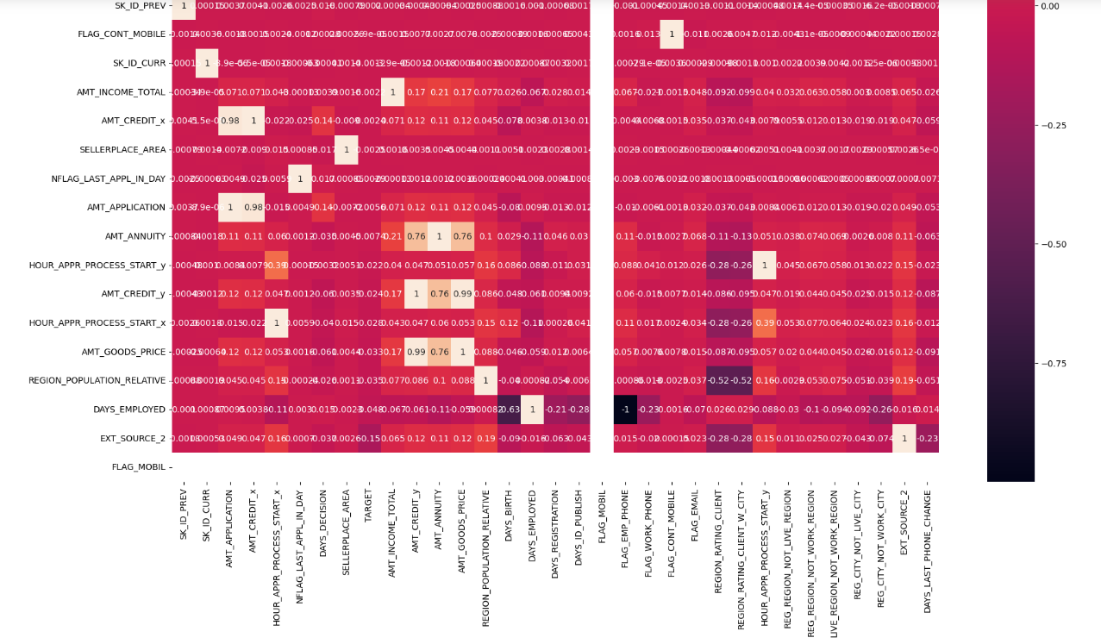
Conclusion
Piling up after the analysis we merged the data from previous_data dataset and we found some more details about previous defaulters are still defaulters or not also the newcomers which have no previous data. From the analysis, we can conclude that application dataset current one shows clearly defaulters and non defaulters as TARGET in respective column while in previous data there’s some things missing but for that we need to keep up the defaulters and new comers in separate columns so that its easy to manage and give loans to the clients with clear background asap.

